Slide 2
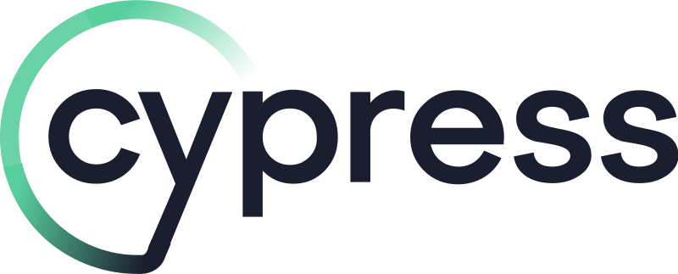
Introduction to

Slide 3
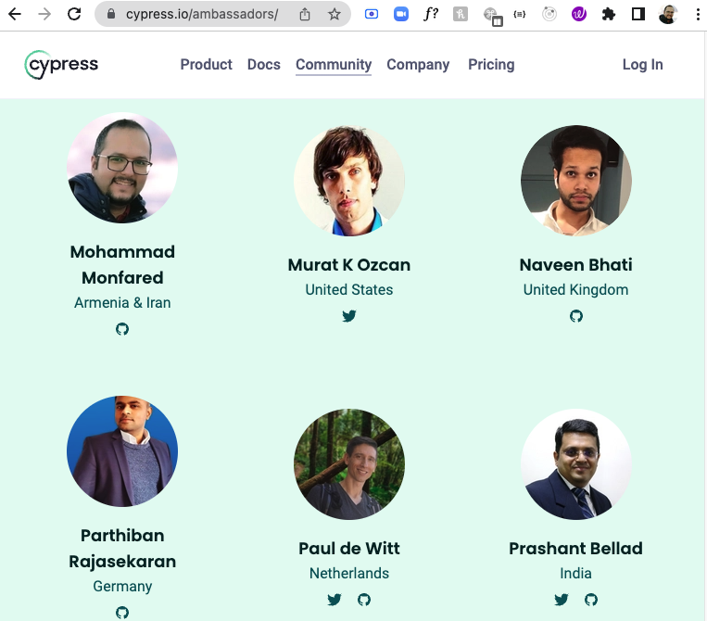
About me
Mohammad Monfared
+8 Years in QA
+6 Years in Automation (Py/JS)
YouTuber / Blogger / Mentor
Cypress Ambassador :)

Slide 4
Agenda
What is Cypress?
Why Cypress? (Features / Pros / Key differences)
Trade-offs and Cons
Comparison table
Docs / Repo / Learn / Samples / Dashboard
Installation / Folder structure /
First test / Cypress App and Runner
Complex UI test (iFrame/Drag&Drop/Alerts, etc.)
API Automation
Intercept and Mocking
Spy and Stub
Clock
Q & A

Slide 5
What is Cypress?
Cypress is a free and open source MIT licensed testing framework based on JavaScript that can test anything runs on a web browser. (built on Node.js)
It is used for E2E, Unit, Integration, Component and API testing.
Website: https://www.cypress.io/

Slide 6
Open source and Popular
4,600,000 weekly NPM downloads
42K stars on GitHub
Growing demands for Cypress skills within the projects
Can be used by QAA and Frontend developers
Fully integratable with FE projects covering all types of the test pyramid

Slide 7
Better Architecture
Faster than Selenium: Interacts with browser session directly in the same loop as app, not through webdriver; which makes the fast, consistent and reliable tests that are flake-free.

Slide 8
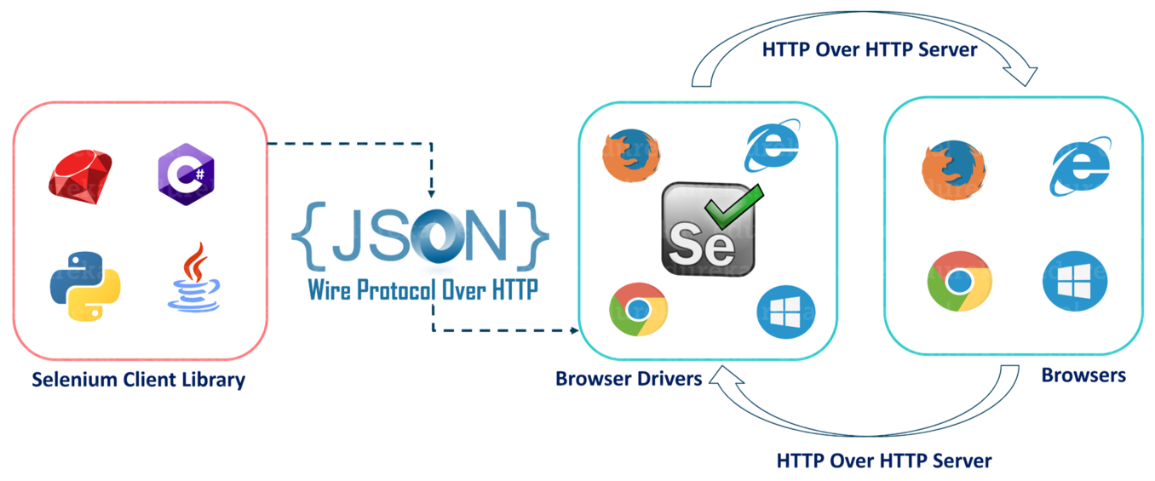
Selenium Architecture

Slide 9
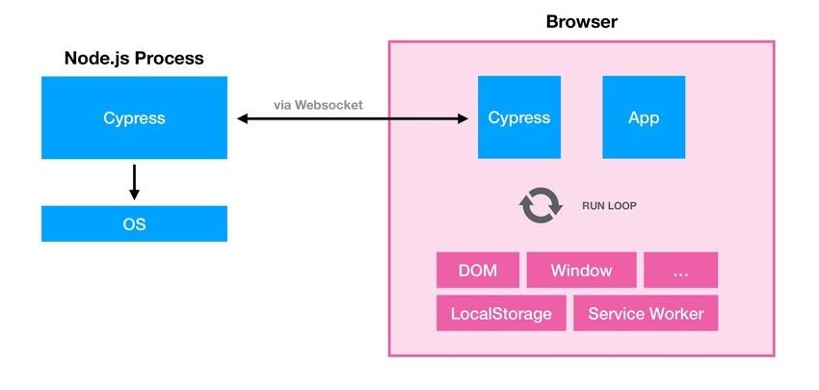
Cypress Architecture

Slide 10
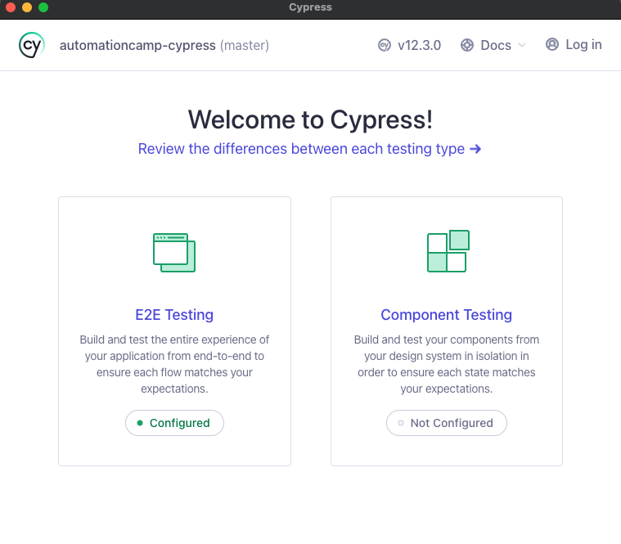
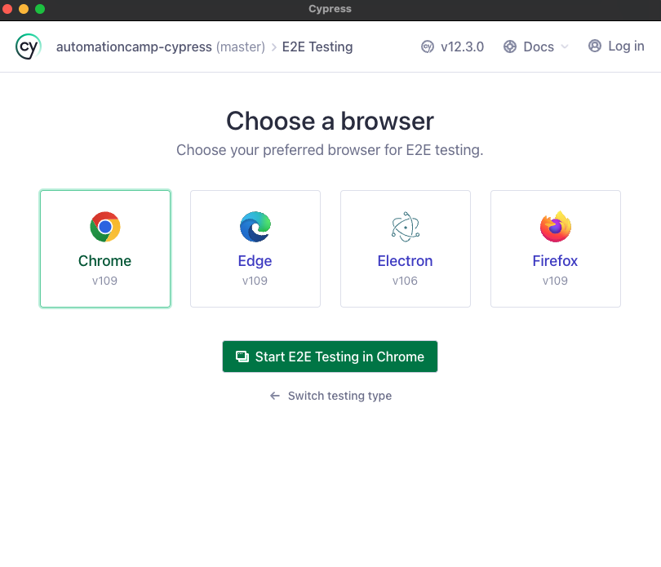
GUI (Cypress App)

Slide 11
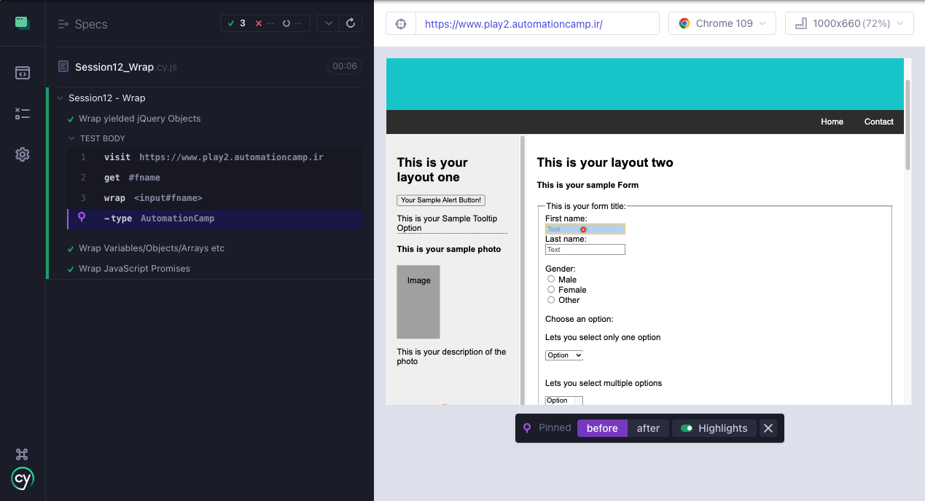
GUI (Cypress Runner)

Slide 12
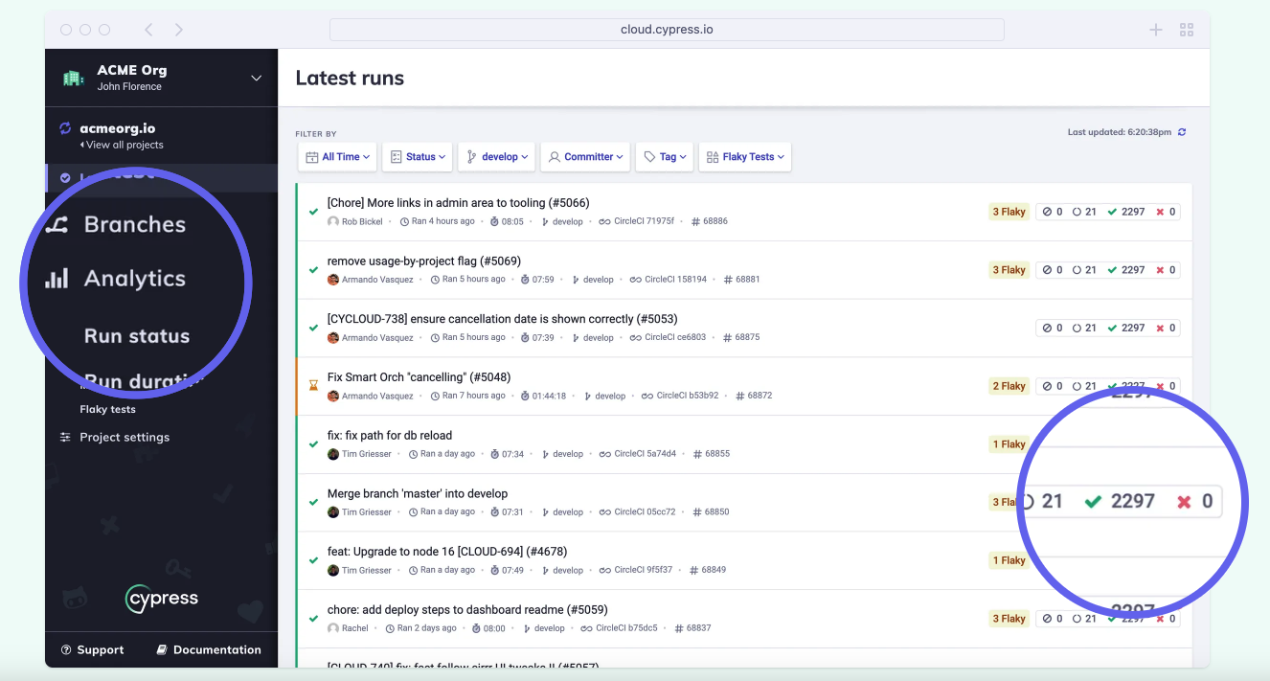
Cypress dashboard (Cloud)

Slide 13
Debuggability
Time Travel : Getting Snapshot of all actions
Screenshots and Video Records
User has access to DevTools
Pause and Play feature

Slide 14
No more flaky tests!
Automatic wait for actions
Automatic assertions for actionability of elements
Flaky test detector in Cypress dashboard

Slide 15
Programmatically Control
Session: Control local storage/cache/cookies | handle session and multi sessions
Stub: Verify and control the behavior of functions
Clock: Control the application time (tick forward)
Spy: Listen to function calls
Intercept: Mocking the and control the network
Login programmatically: Login using API and set storage
DOM Manipulation: Remove, add attributes / manipulate window and document objects/ run browser functions, etc.

Slide 16
Robust Documentation
Complete guide for almost anything
API docs with multiple examples
Best practices / do's and don'ts
etc.

Slide 17
Big community backed by Cypress company
Discord server
GitHub Discussions
Ambassadors
Events
Roadmaps
etc.

Slide 18
Different ways for learning
Learn center
Real World App with a lot of examples
Tutorials
Guides page
Example recipes
YouTube channel
Blog

Slide 19
More …
Real time reloads
Cypress dashboard (Real Sample)
Plugins
Bundled with jQuery, Mocha, Chai, Sinon, etc.
Easily integrate with CI
Cypress studio
Component testing
Visual Testing (applitools, percy, happo, etc)

Slide 20
Cons and Trade-offs
Since it runs in the browser, it supports only JavaScript and TypeScript. It makes it a little bit harder to communicate with the backend - like your server or database.
It doesn't support multiple Tabs and Windows.
You can't use Cypress to driver two browser instances like multiple sessions in selenium
It doesn't support native mobile applications
> Read more about trade-offs
Notes:
geeg

Slide 21
Comparison Table
Feature | Selenium | Playwright | WebdriverIO | Cypress
Time Travel | No | reports should upload to their website (very limited) | No | Yes
GUI App for run and report | No | No | No | Yes
Multi tab/window/instance support | Yes | Yes | Yes | No
Actionability checks | No - should be implemented | Limited | Limited | Yes
Manipulate DOM | No | Limited | Limited | Yes
Cross-browser | All | Chrome family | All | Chrome family, Edge, Firefox, Electron, Webkit (Safari)
Parallel testing | Yes | Yes | Yes | Yes
Native-mobile app testing | Yes (appium) | No | Yes | No
Supported language | All popular | JavaScript/TypeScript/Python/Java/.Net | JavaScript/TypeScript | JavaScript/TypeScript
Component testing | No | Limited | Yes | Yes
Mocking / Interception | No | Limited | Limited | Yes
Manipulate app & bowser clock | No | No | No | Yes
Cross origin | Yes | Yes | Yes | using cy.origin

Slide 22
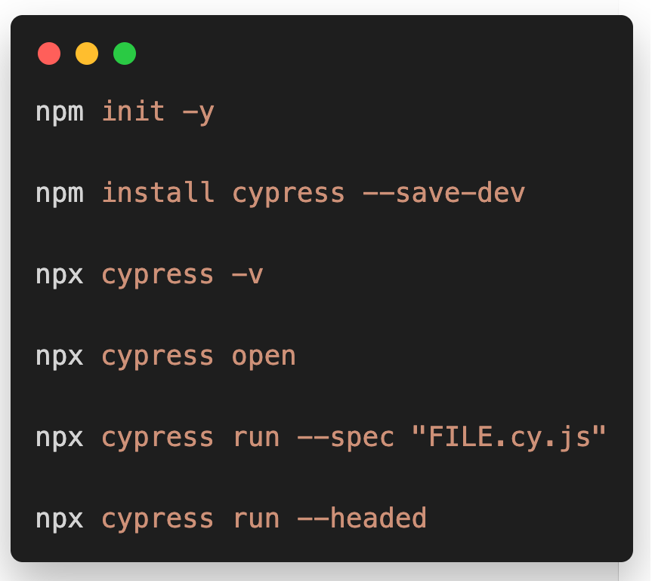
Install and CLI
Initialize Node.js Project
Install Cypress and add as dev dependency
Check version of installed Cypress
Open Cypress GUI (and initialize on first time)
Run tests from CLI (headless by default)
Run tests headed from CLI

Slide 23

Questions & Answers
https://www.linkedin.com/in/mohammad-monfared/
http://www.monfared.io/

